Slide 1
To become saints as Church
Chiara Lubich
September 25, 1970

Slide 2
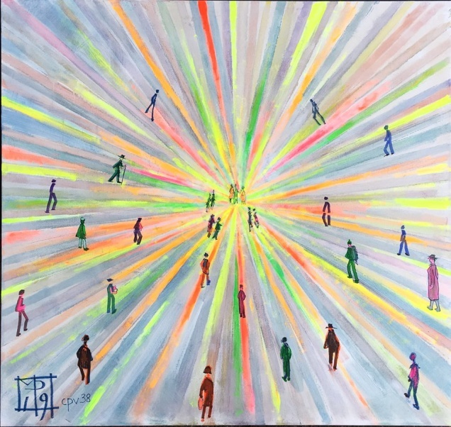
How easy it is to notice a profound
desire beginning to take hold in
Christians; I would even call it
an urgency.
They show a desire to serve the Church ,
not so much and not only in outward,
material ways but in
a different manner,
more in tune
with their faith,
more essential.

Slide 3
One sees, especially among laity,
that the way people used to think
about becoming saints
is not much appreciated;
indeed at times
they consider it
outdated.

Slide 4
The style of sanctity for today’s
Christian goes beyond that of
perfection sought individually,
and they often express it like this:
we want to
become saints
together...

Slide 5
We desire a
collective
sanctity.

Slide 6
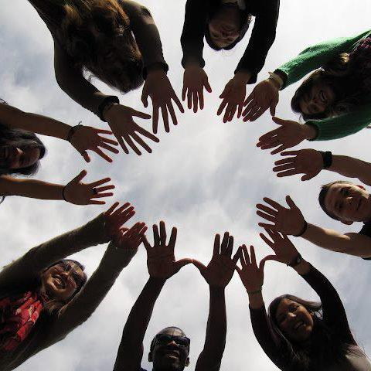
So here and there we see
committed Christians forming
groups who, in unity,
go towards God.

Slide 7
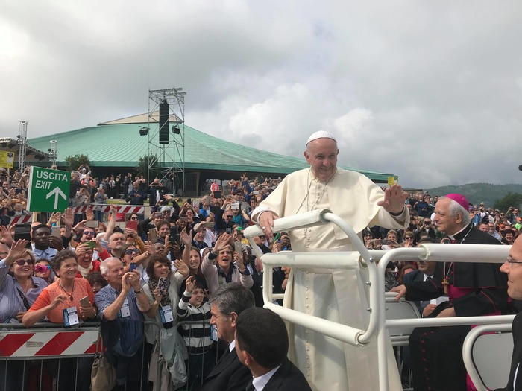
In fact it seems to us that this is
what God really wants,
so long as it all has the stamp
of openness,
the pulse of
the entire Church,
a loving unity
with the hierarchy.

Slide 8
The face of the Church,
with Its lights and shadows,
ought to be in every Christian,
in every group
of Christians.

Slide 9
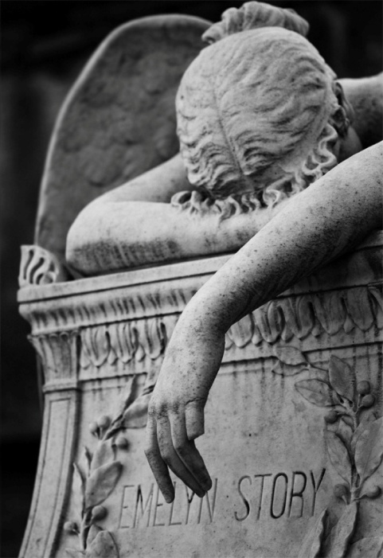
This means that we must feel as our
own not only the Church’s joys,
her hopes, her constantly new forms
of growth,
her victories...
but above all
we must feel
as our own
all of her sorrows...

Slide 10
Like the lack of full unity
among the Churches
lacerating and painful
situations
negative disputes

Slide 11
The threat
of discarding
age-old
treasures...

Slide 12
The anguish that
many deny
or refuse
the message
God speaks
to the world
for its salvation.

Slide 13
In all these afflictions,
above all in the spiritual ones,
the suffering Church appears
as the Crucified Christ of today
who cries out:
“My God, my God,
why have you
forsaken me?”.

Slide 14
Not long ago I was at
Mount La Verna.
There I meditated on
the exceptional gift of the
stigmata that God gave Francis
as a seal of his
imitation of Christ,
of his discipleship.

Slide 15
I was thinking that all true
Christians should be
stigmatics,
not in an extraordinary,
outward sense
but spiritually.

Slide 16
I seemed to understand
that the stigmata of today’s
Christians are the mysterious
but real sufferings of the
contemporary
Church.

Slide 17
If the charity of Christ is not
wide enough in us to feel
in ourselves the pain
of these wounds,
we are not
how God want
us to be today.

Slide 18
In these times,
only an individual
sanctity is not enough,
nor one that is communitarian
but closed.

Slide 19
We must feel within
ourselves the sorrow
and also joy
that Christ
experiences
today in his Bride.

Slide 20
We need
to become saints
as Church

Slide 21
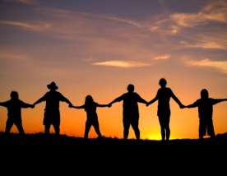
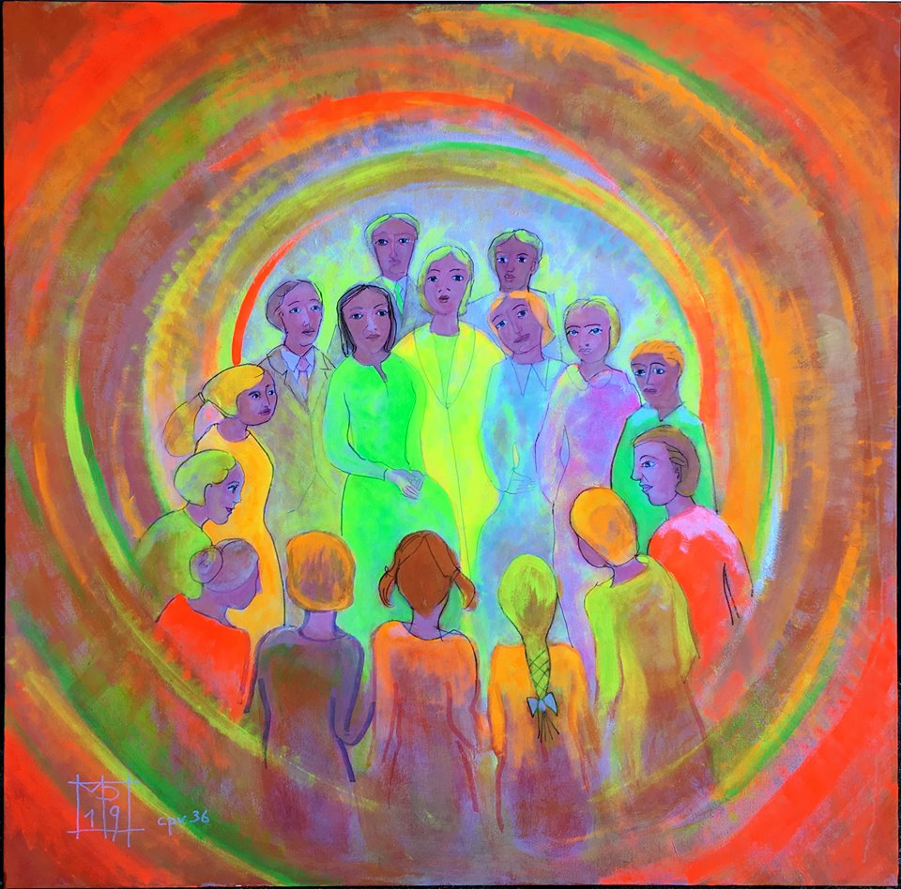
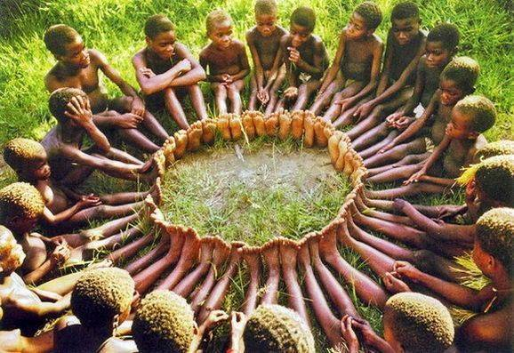
To live a collective sanctity

