Slide 3
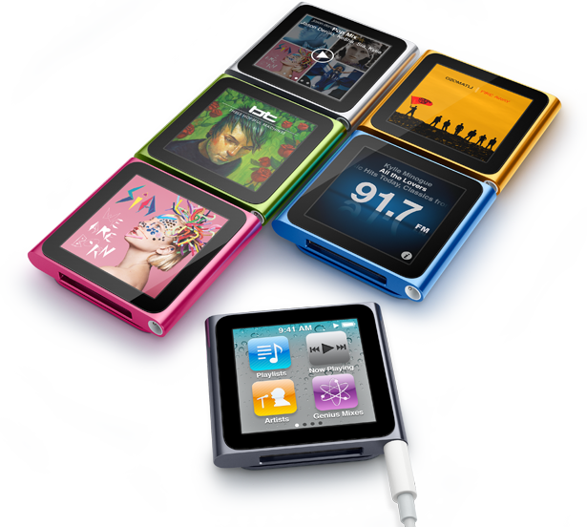
100% musica!!!
multi-touch!!!

Slide 4
SALDI!!!
70%

Slide 5
BE FASTER!
THE TIME IS
YOURS!!!
www.mountainsports.com

Slide 6
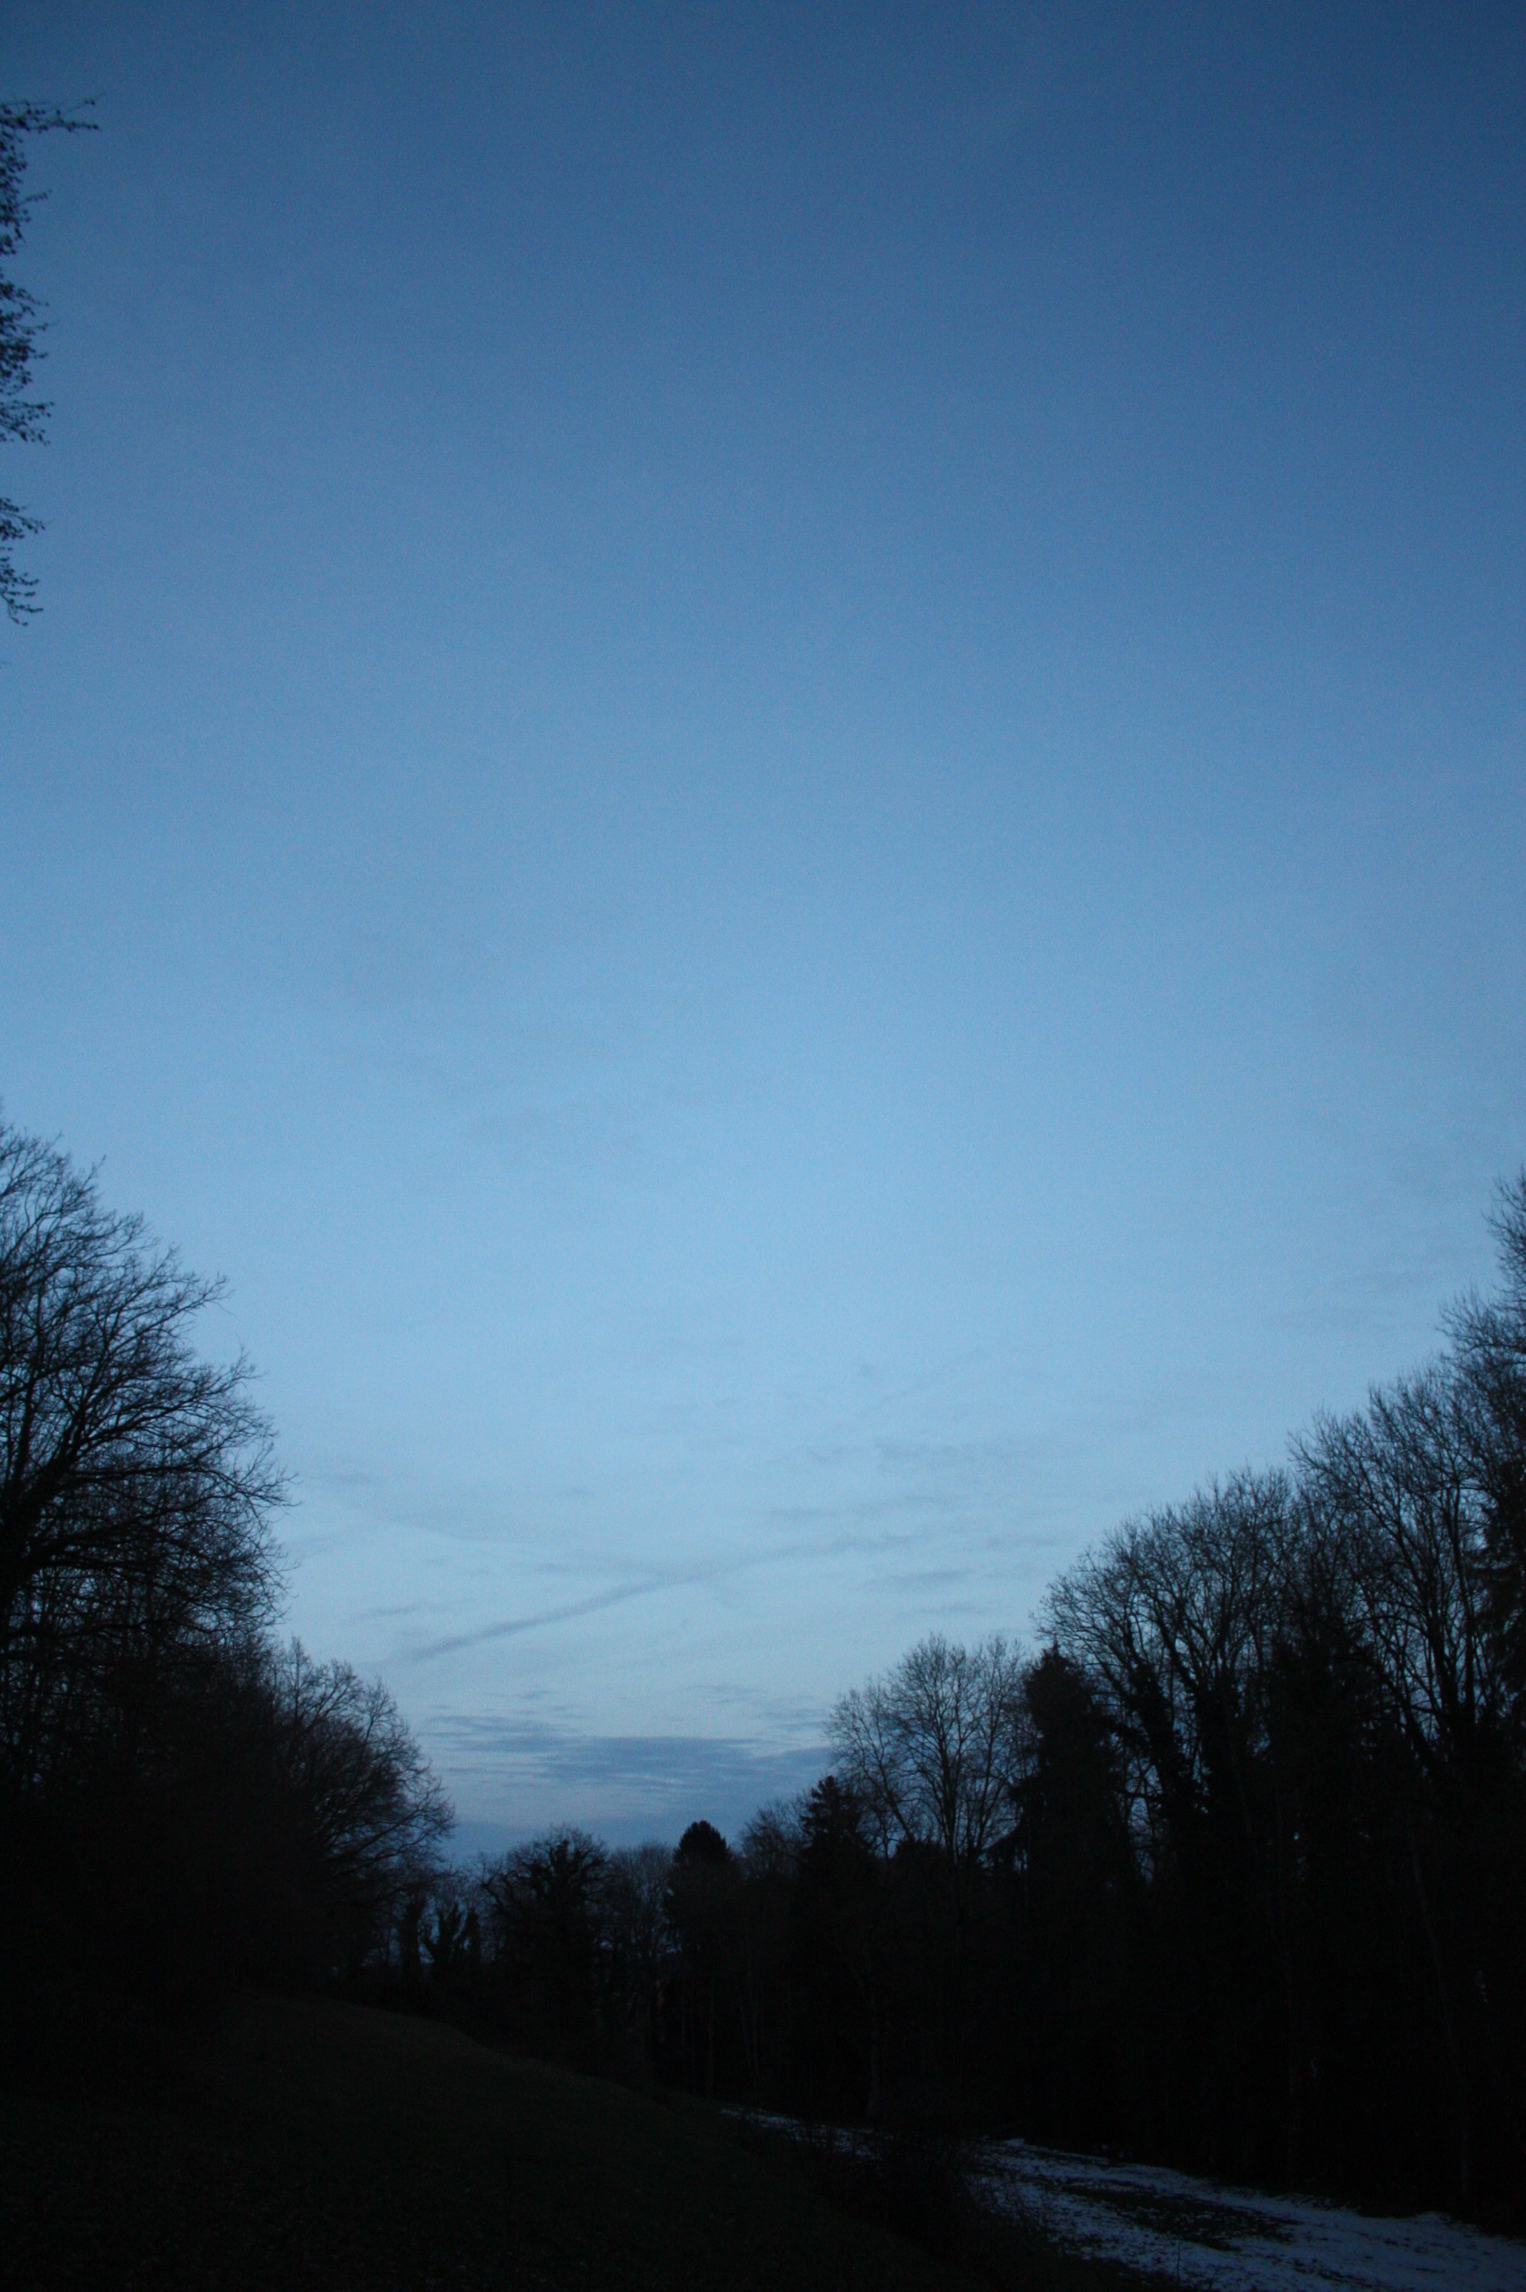
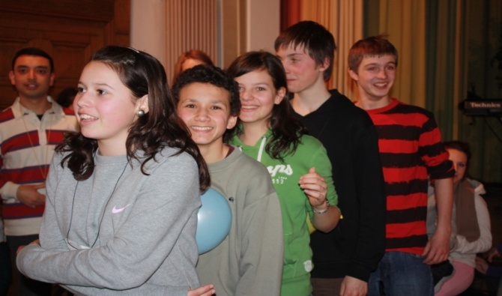
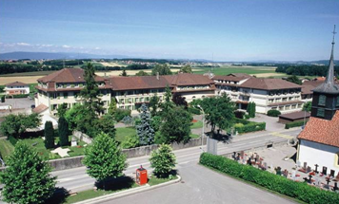
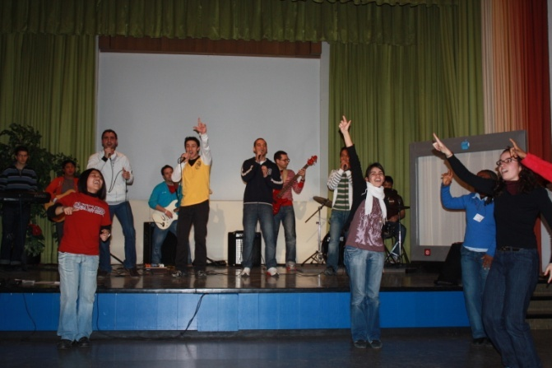
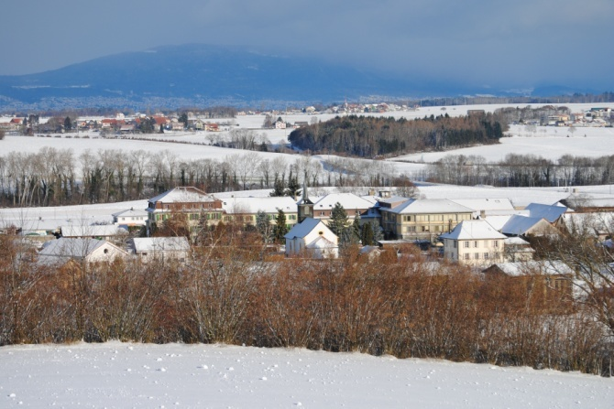
Follow the Light
tour

Slide 10
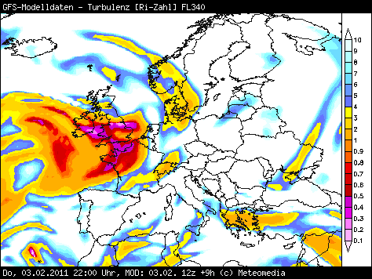

Slide 11
7°
ZURICH
BERN
20°
MONTET
15°
GENEVA
10°
LUGANO

Slide 22
L'arte moderna di
Lara
Da Pincy

Slide 27
Terminals
AT
AS
AP
F1

