Slide 1
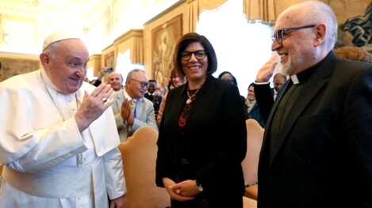
POPE FRANCIS
DECEMBER 7, 2023
AT THE GENERAL COUNCIL
OF THE FOCOLARE MOVEMENT

Slide 2
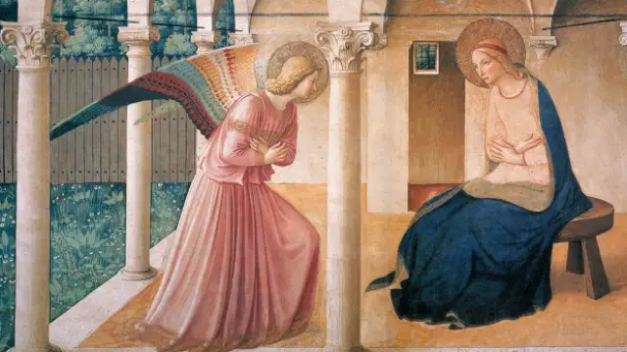
The « yes » of Mary became the « yes » of Chiara

Slide 3
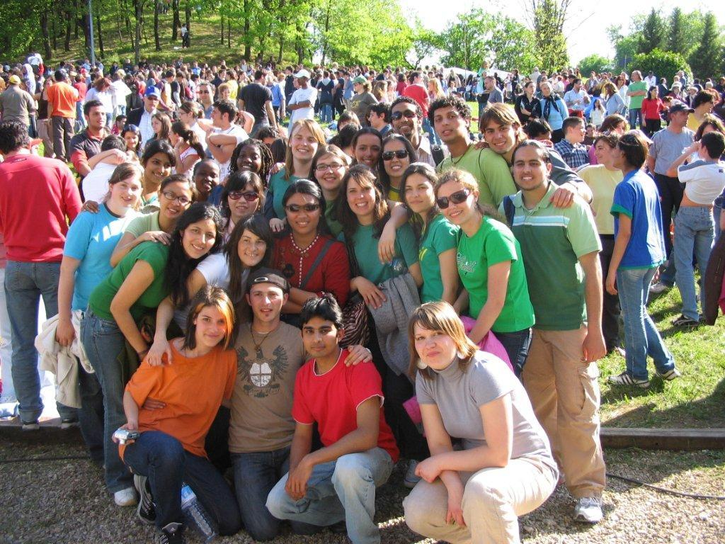
During those 80 years
you have made this message of unity resound...
Amid the young,

Slide 4
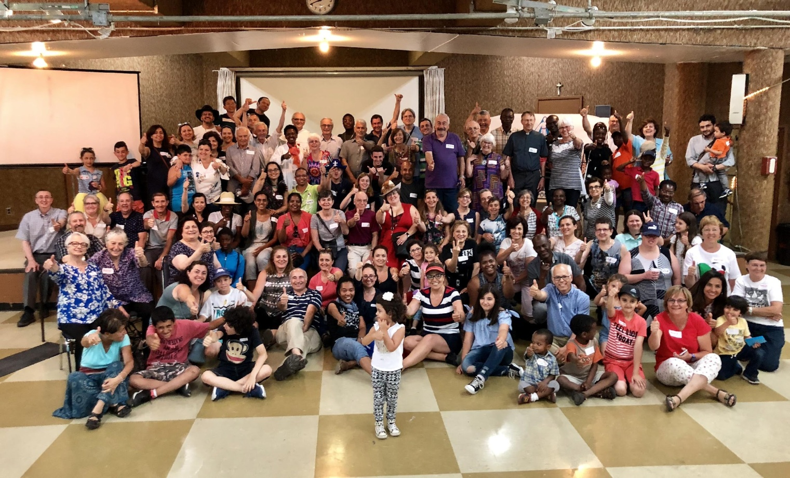
Amid the communities,

Slide 5
The families, …

Slide 6
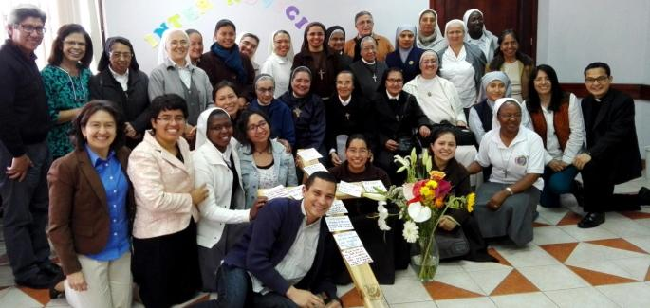
Persons of consecrated life,…

Slide 7
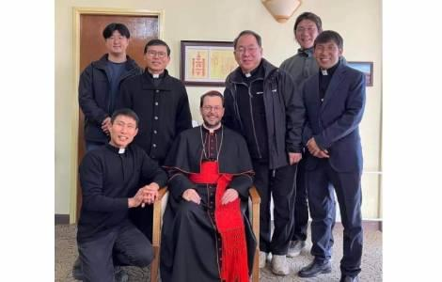
The priests,…

Slide 8
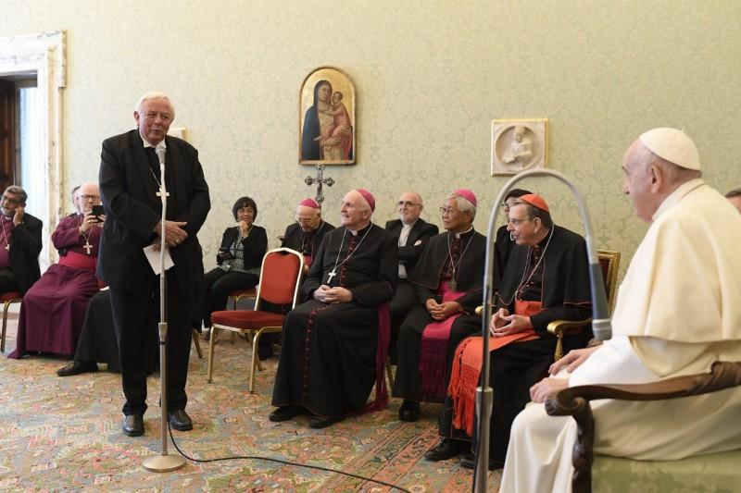
the bishops

Slide 9
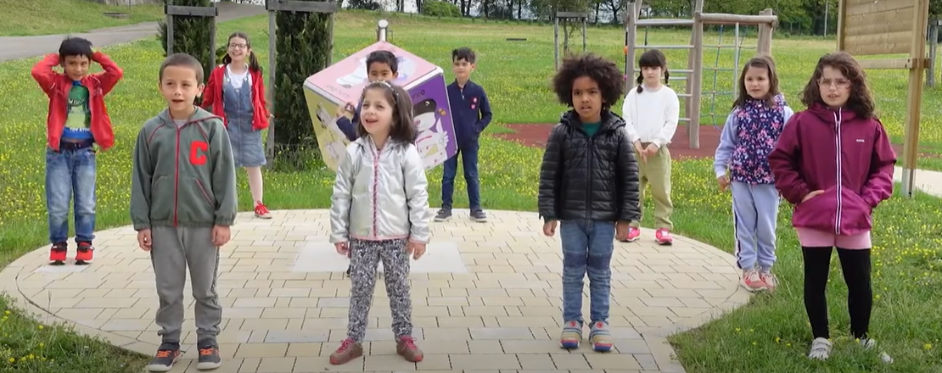
In the schools,

Slide 10
in the world
of economy, …

Slide 11
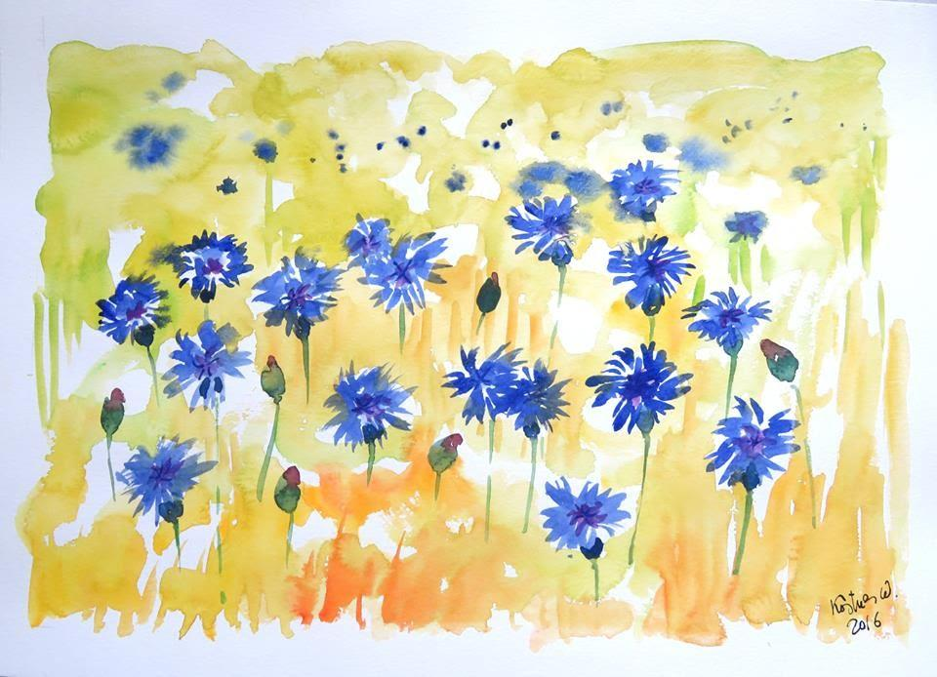
In the world of art
and culture, …

Slide 12
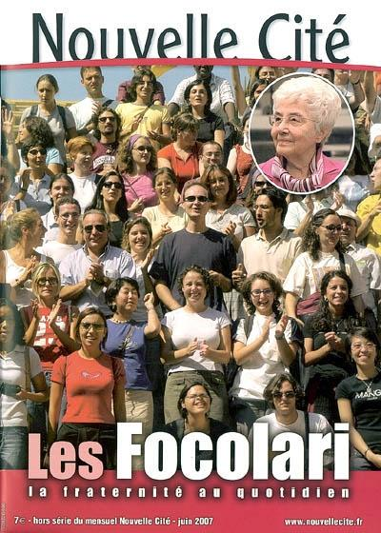
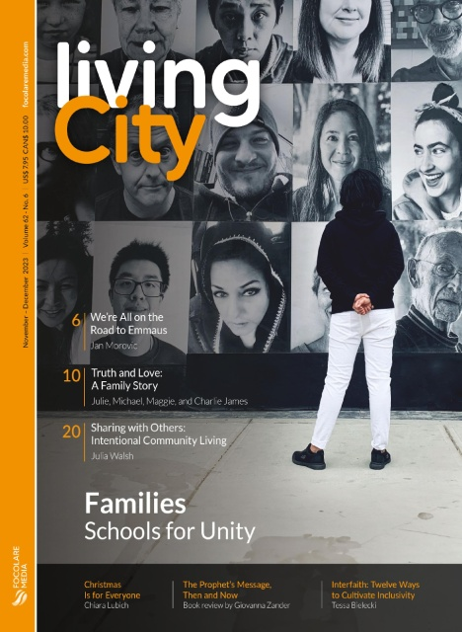
in the world of the media and information

Slide 13
In ecumenical dialogue, …

Slide 14
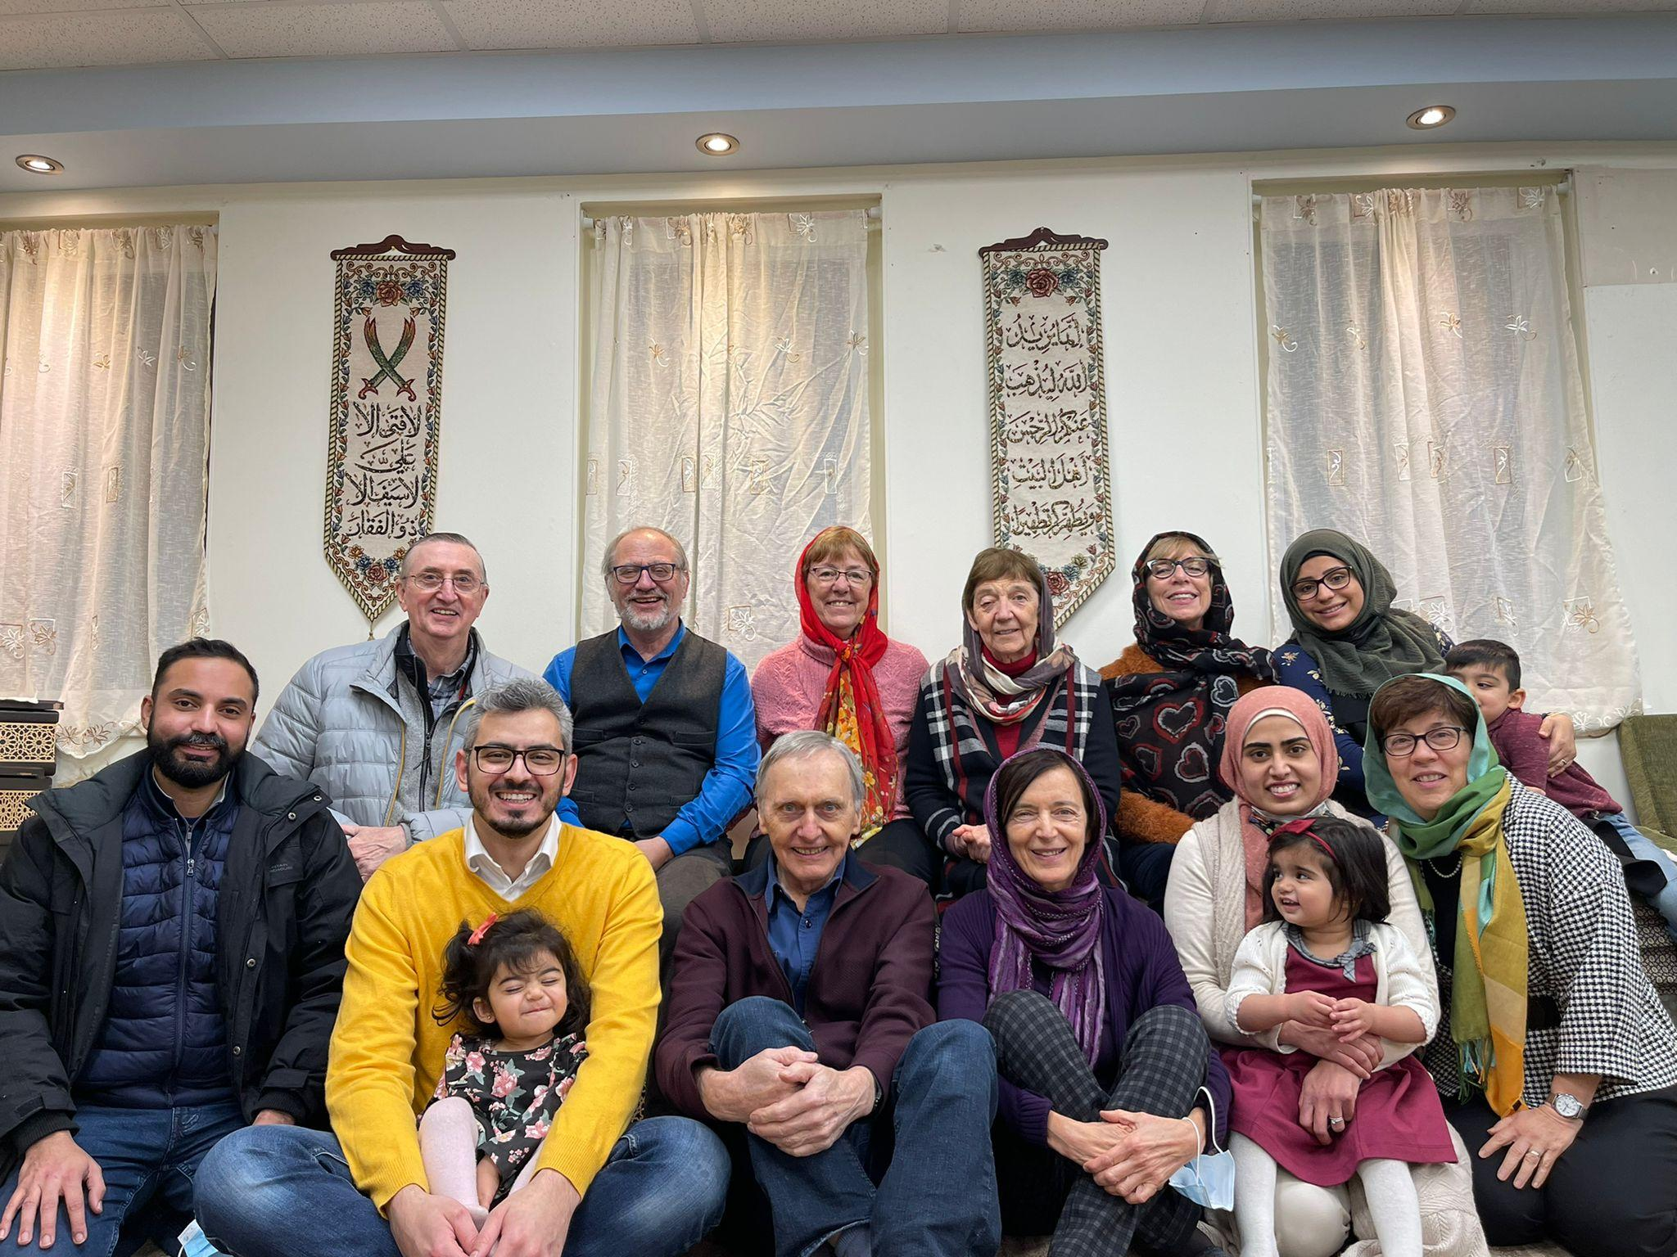
In interreligious dialogue

Slide 15
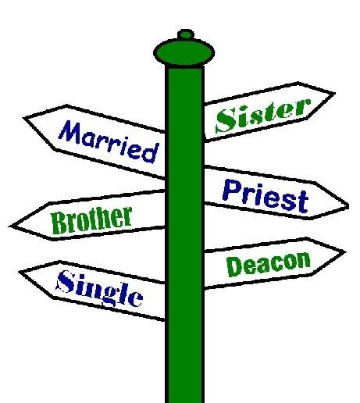
« Rebirths » of conversions
and vocations

Slide 16
In 2021, 3 points :
1. Dynamic fidelity
2. Crises = opportunities
3. Embodying spirituality
Today, 3 points:
1. Ecclesial maturity,
2. Fidelity to the charism,
3. Commitment to peace

Slide 17
1. Ecclesial maturity
A synodal and missionary Church
Listening
Family warmth
Watch out for the weakest

Slide 18
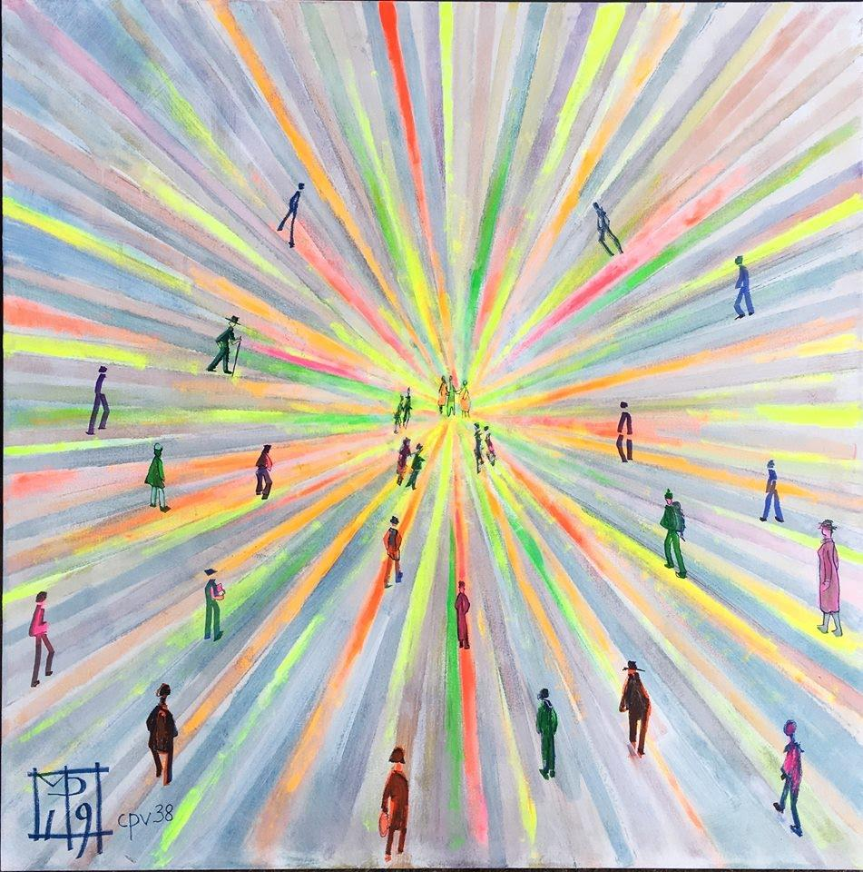
2. Faithfulness to the charism
Chiara Lubich understood that Jesus said her:
"Leave to those who follow you only the Gospel. If you do this, the ideal of unity will remain" ...

Slide 19
3. Commitment to peace
Only from love is the fruit of peace born

Slide 20
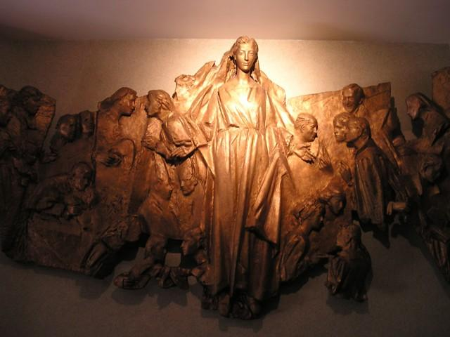
To conclude:
Beware of inconsistency between what we say we are and what we truly are.
May Mary continue to accompany her Work
"Work of Mary".

