Slide 1
Confirmation Retreat
Saturday November 27, 2021

Slide 2
Themes of the day & Retreat Overview

Slide 3
“How can we be the teenager God Calls us to be?”

Slide 4
Themes:
Being a saint
The Holy spirit, the “yes”

Slide 5
Schedule
Icebreaker
We are going to meet some young saints!
Lunch
Reflect on the Holy Spirit
Time in the Chapel
Final Meditation

Slide 6
Icebreaker!

Slide 7
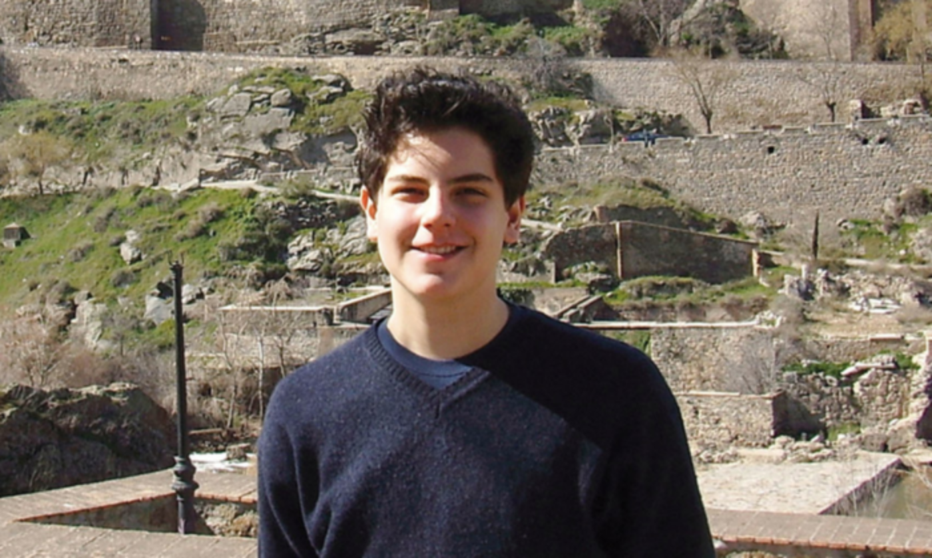
Blessed Carlo Acutis

Slide 8
Video

Slide 9
Reflection Questions

Slide 10
In what way was carlo Acutis a regular, everyday boy?
Do you share any hobbies with him?
In what way can you live more like Carlo?

Slide 11
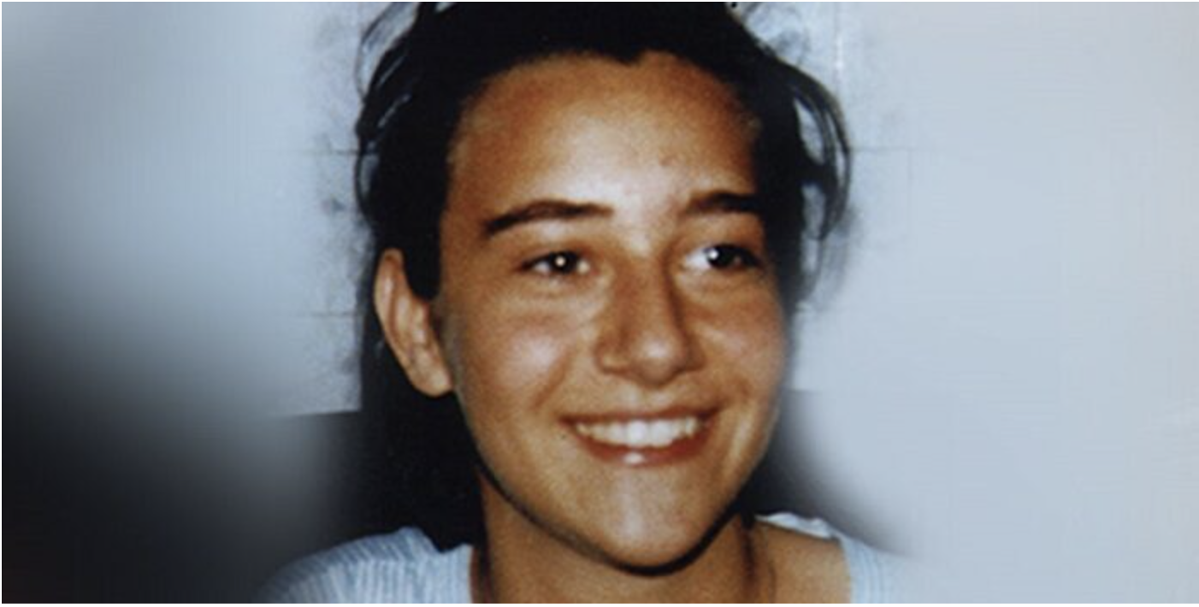
Blessed Chiara Luce Badano

Slide 12
“Gen” Movement
(What does gen stand for)

Slide 13
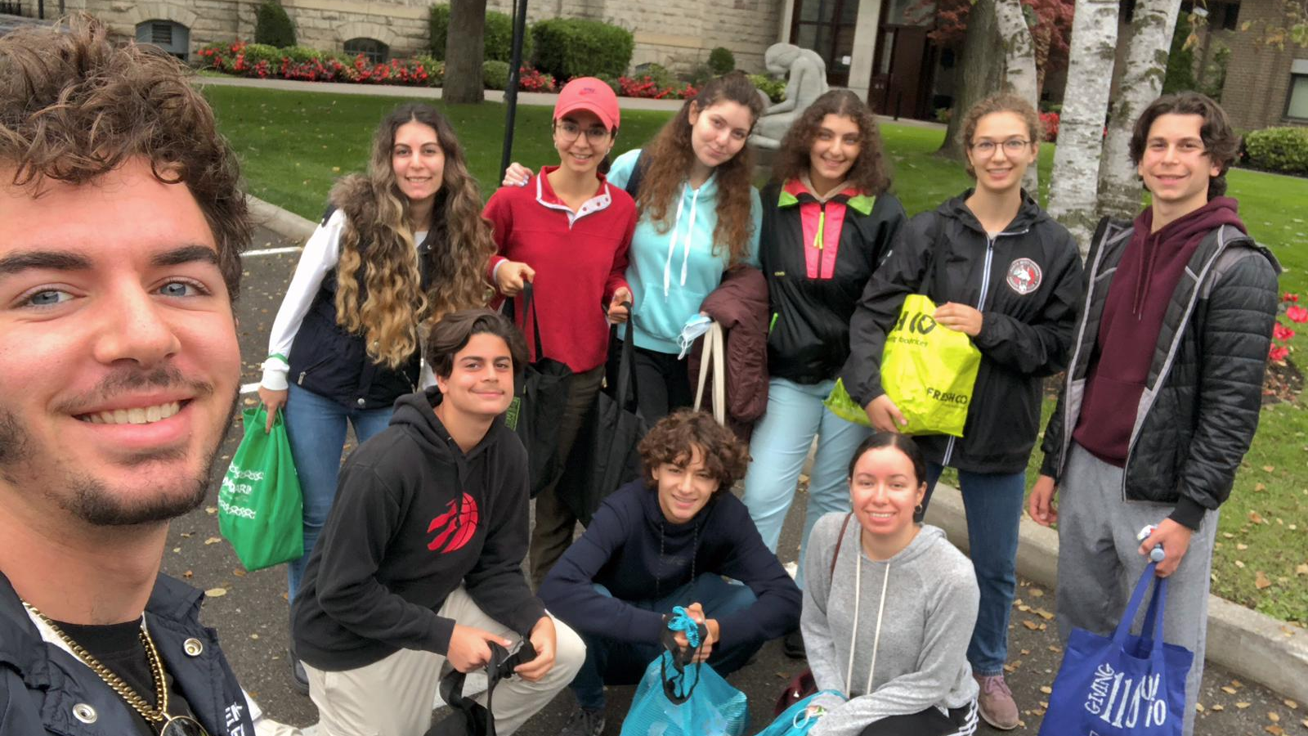
Gen of Toronto!

Slide 14
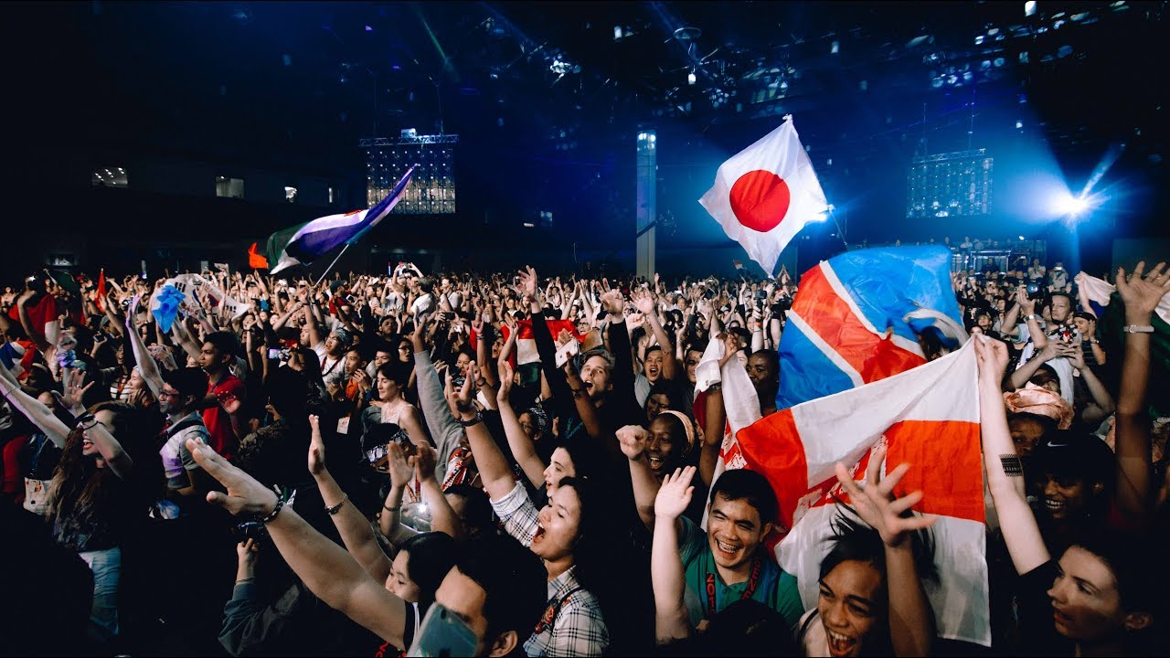
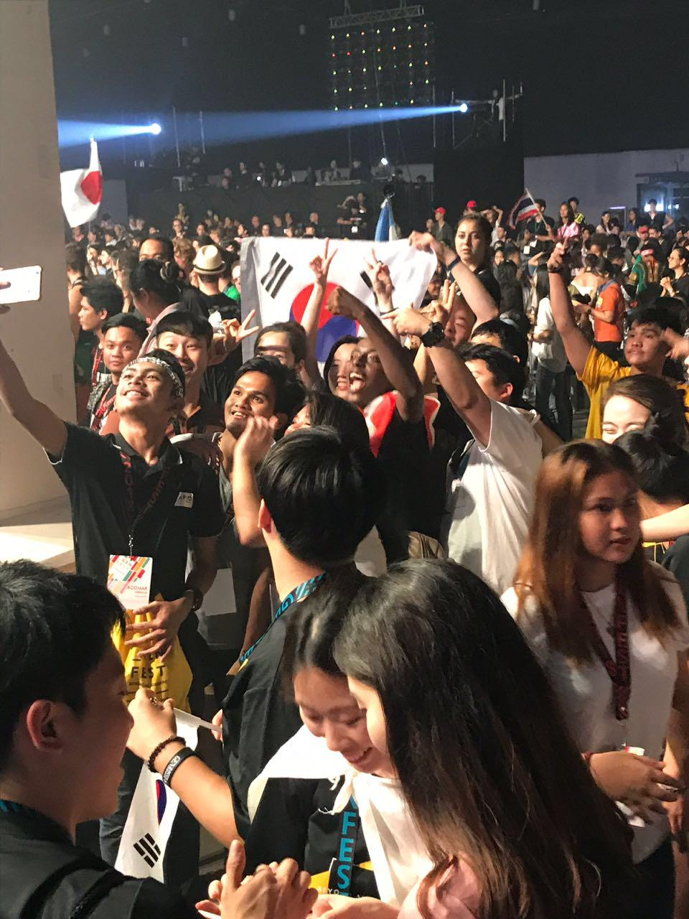
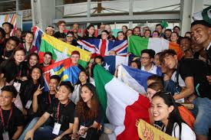
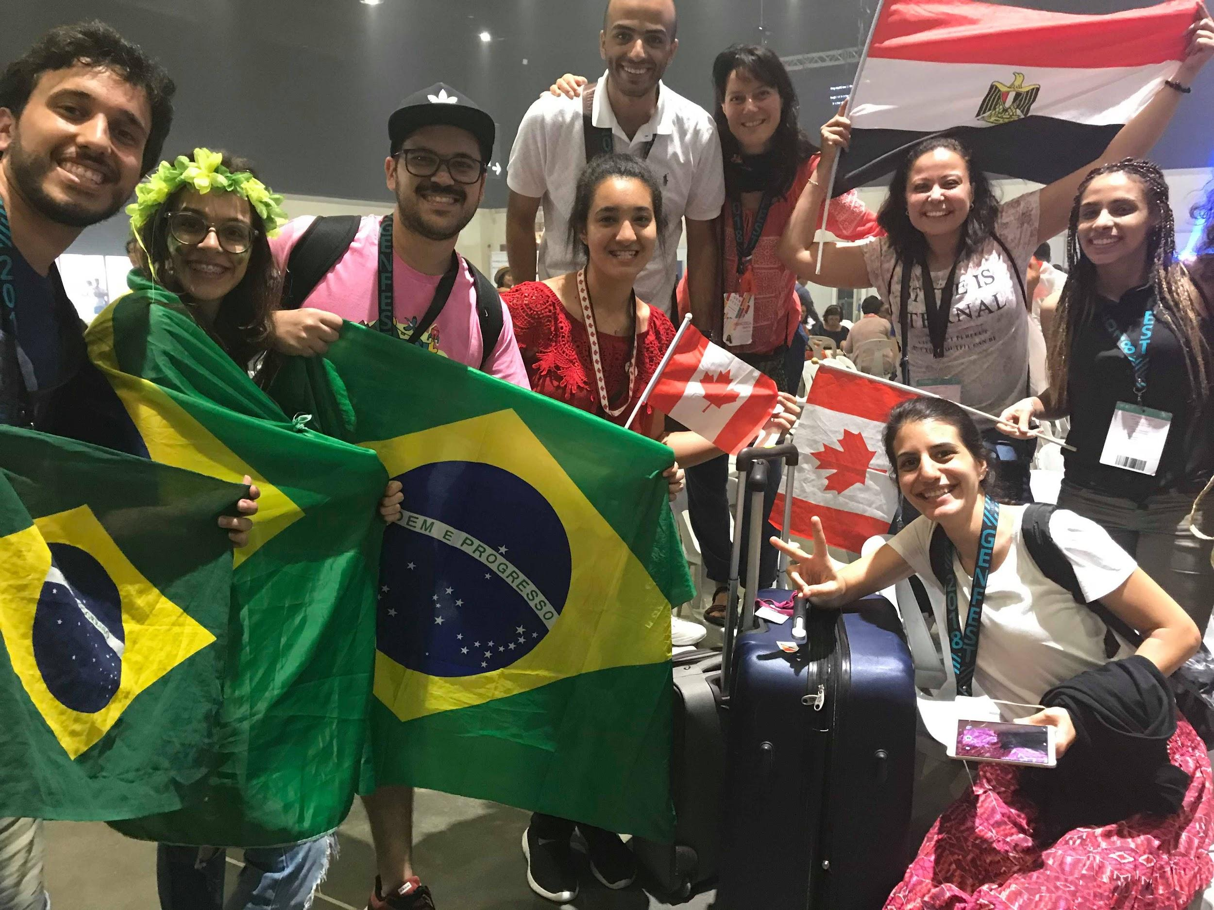
Gen of the world!

Slide 15
Blessed Chiara Luce Badano was “a gen” from Italy :)

Slide 16
Video

Slide 17
St. JosÉ SÁnchez del RÍo (14)
St. Dominic Savio (14)
St. Joan of Arc (19)
St. Pedro Calungsod (17)
SO many More young saints to discover!

Slide 18
Lunchtime, yum yum!

Slide 19
Come, Holy Spirit!

Slide 20
Reflection Questions

Slide 21
Chiara said the Holy Spirit is like “The light Before us”, what does that mean in your heart?
When was a time that you felt the holy spirit?

Slide 22
Prayer time

Slide 23
Bringing it All together -
Young Saints, Holy Spirit, “the Yes”

Slide 24
Let’s talk about
Mother Mary!

Slide 25
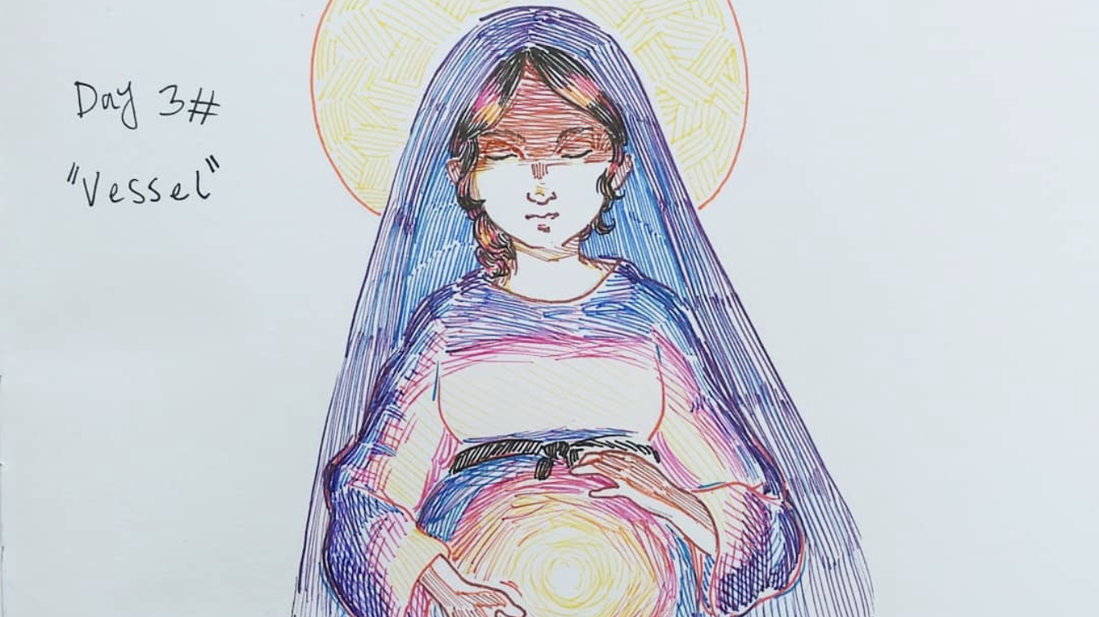
How old was she?

Slide 26
She was 14/15!
(When she said “Yes” to being the Mother of Jesus)

Slide 27
If Holy Mary was a teenager, what does that mean for you?

Slide 28
Her “yes” is so sacred, there’s even a name for it, “Fiat”

Slide 29
“Behold, I am the servant of the lord; let it be done unto me according to your word.”
-lUke 1:38

Slide 30
In this way, Mary shows us exactly how to be a saint!
Her example gives us a roadmap

Slide 31
She also shows us how to receive the Holy Spirit! When Mary said yes, she also Received the Holy Spirit :)

Slide 32
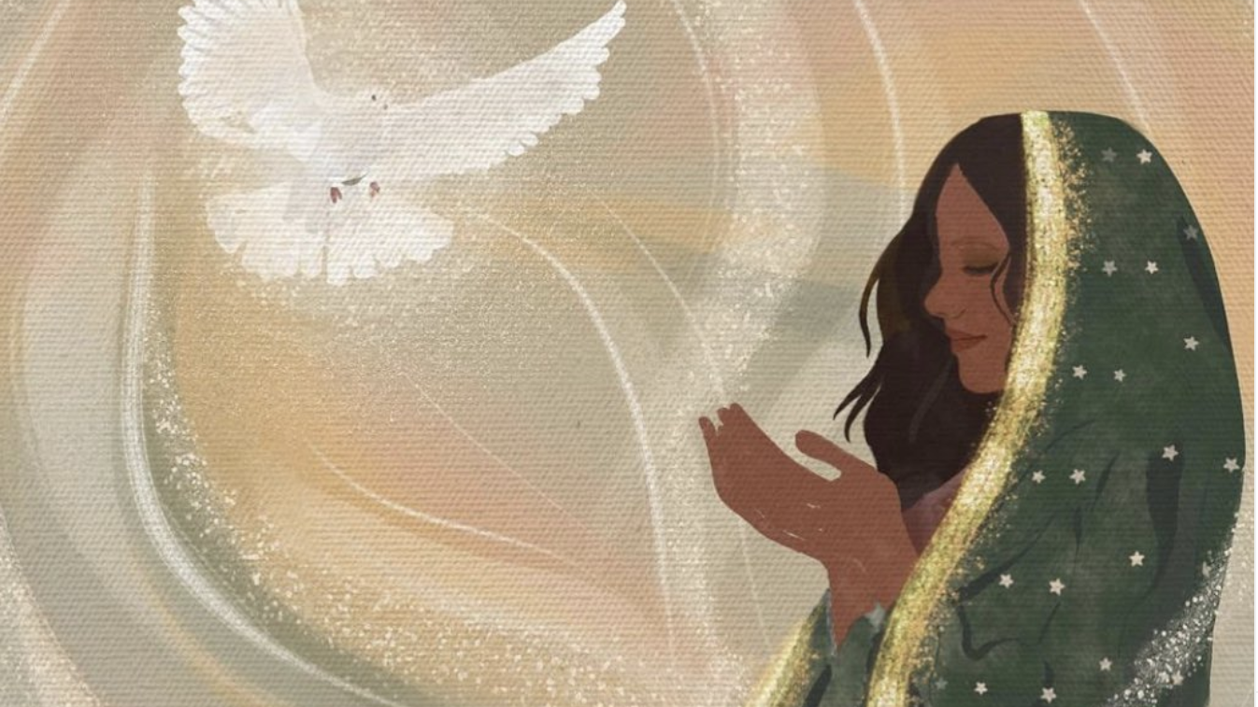
Mary Receives the Holy Spirit

Slide 33
Let’s give our “yes” ahead of confirmation & also everyday

